Slide 1
SEM Project
Charith Atapattu.
Mahdi Moradi
Ali Khamesipour

Slide 2
Quality Score
Expected CTR
Ad relevance
Landing page experience
The last two are important for high quality scores.

Slide 3
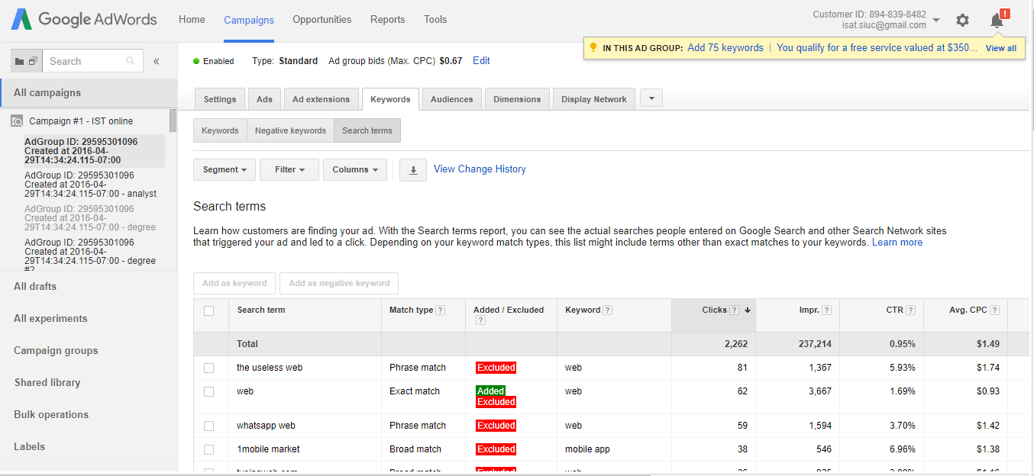
Track the search terms

Slide 4
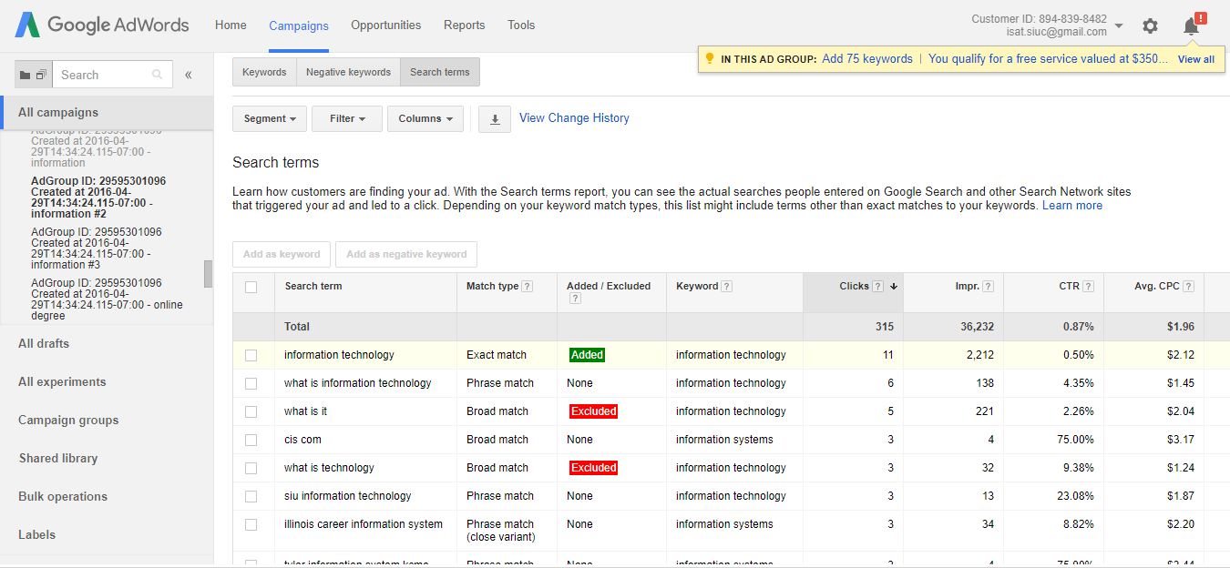
Continue

Slide 5
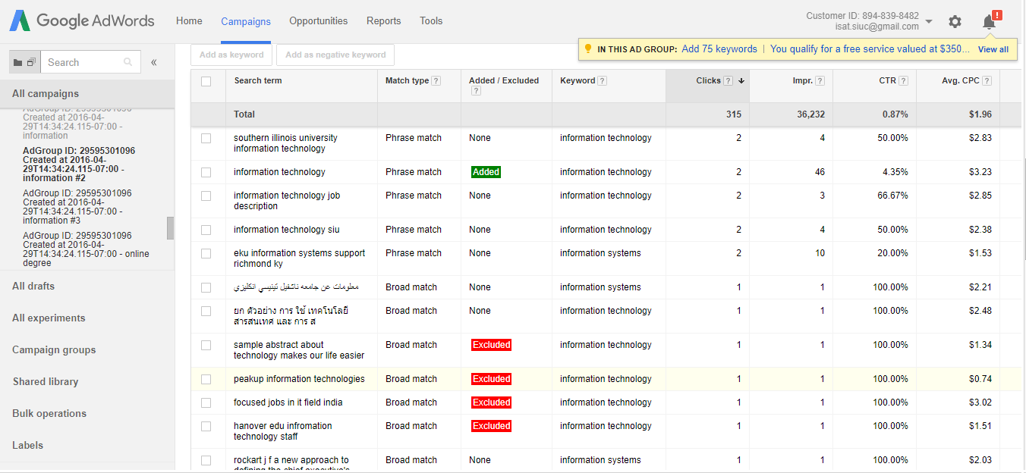

Slide 6
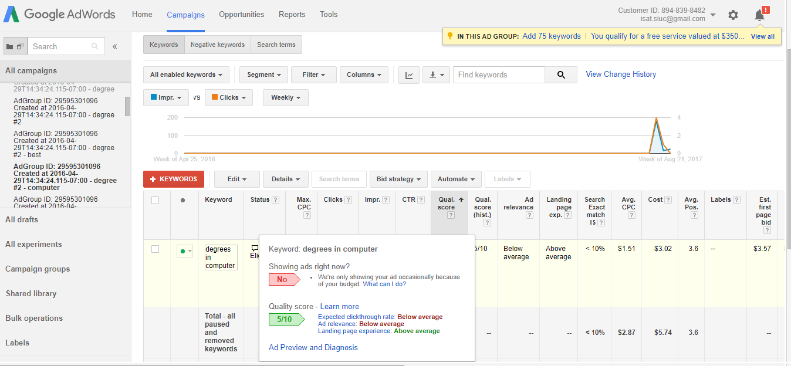
Track the keywords

Slide 7
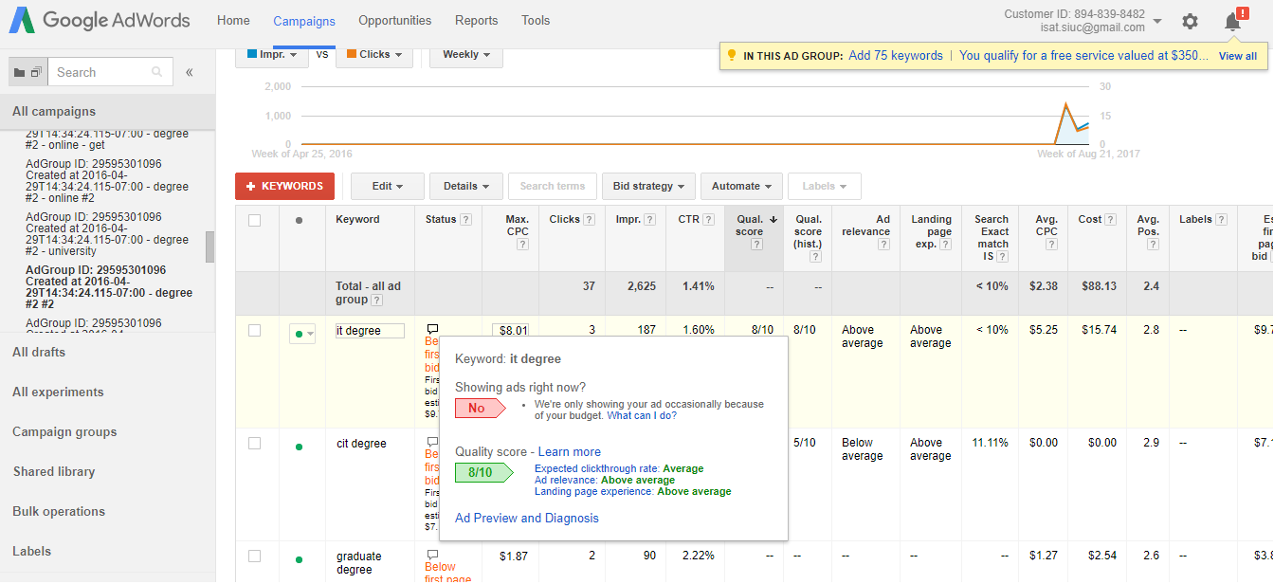

Slide 8
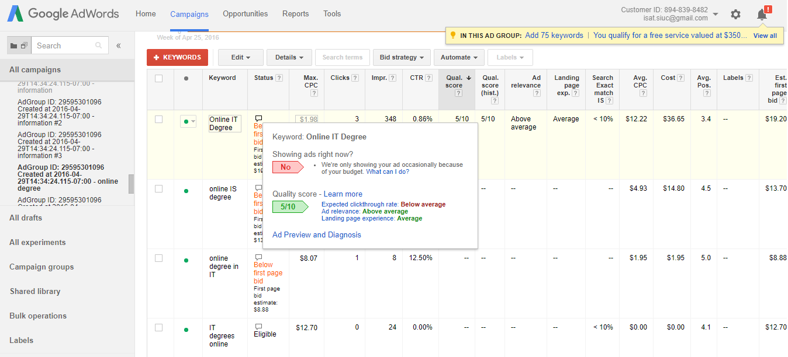

Slide 9
Tasks
Analyzing Google Analytics
Maintaining GitHub repository
Student Registration form
Using MEAN web technology
Mail and SMS service integration

Slide 10
Google Analytics
Concerns
What are the most visited web pages?
From where they are accessing?
How much time they are using?
What is the accessing device?

Slide 11
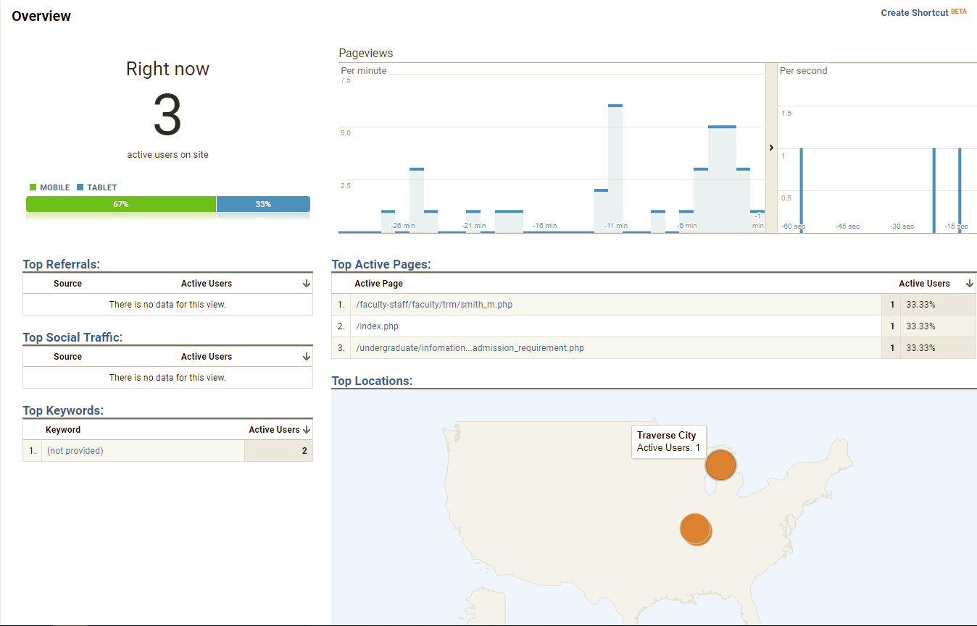
Google Analytics

Slide 12
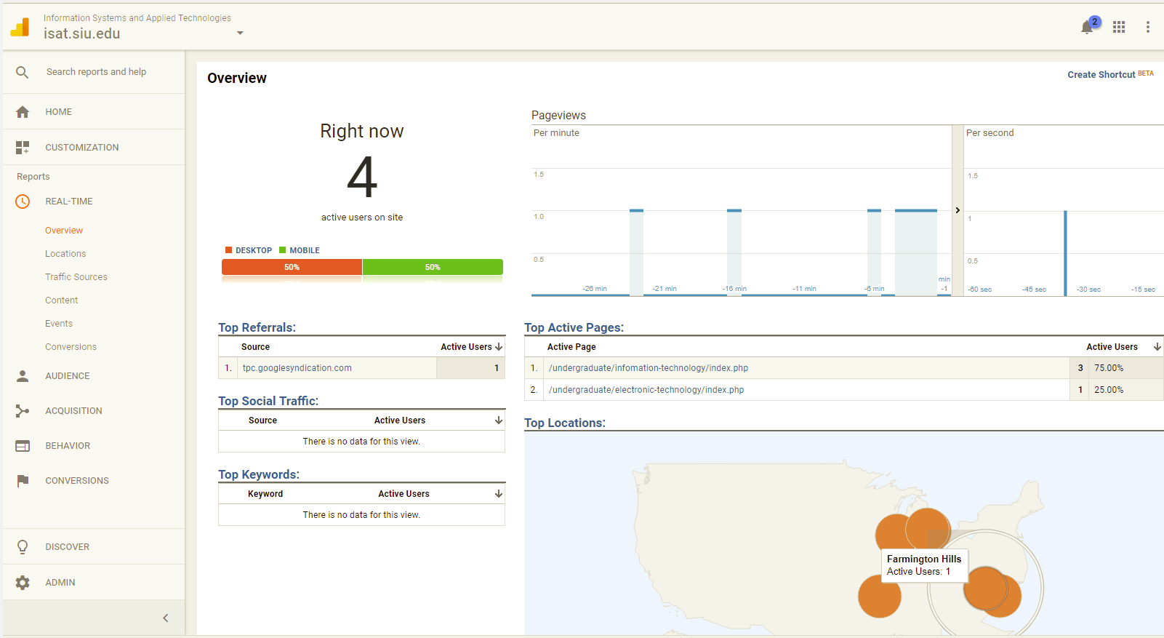
Google Analytics

Slide 13
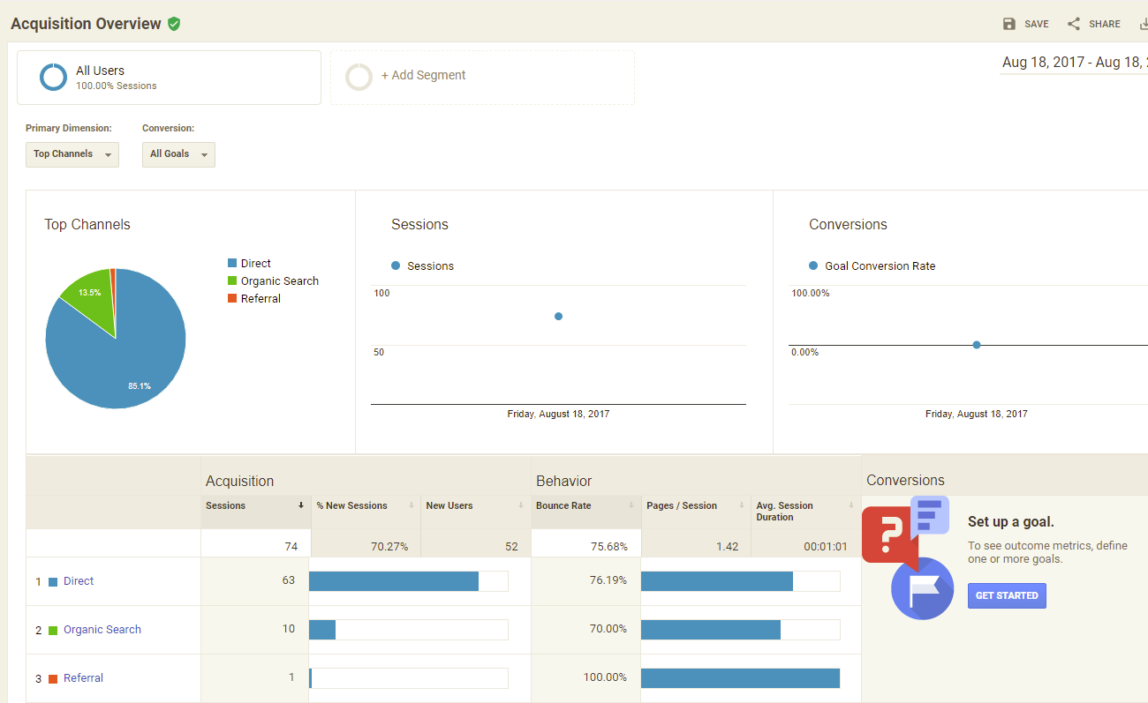
Google Analytics

Slide 14
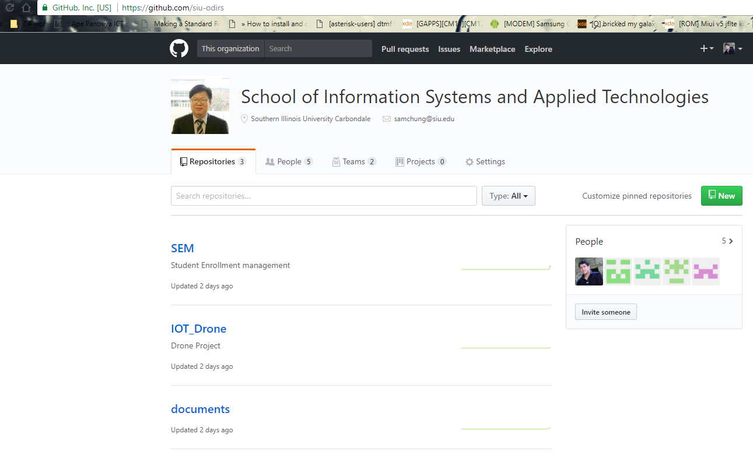
GitHub repository for SEM Project

Slide 15
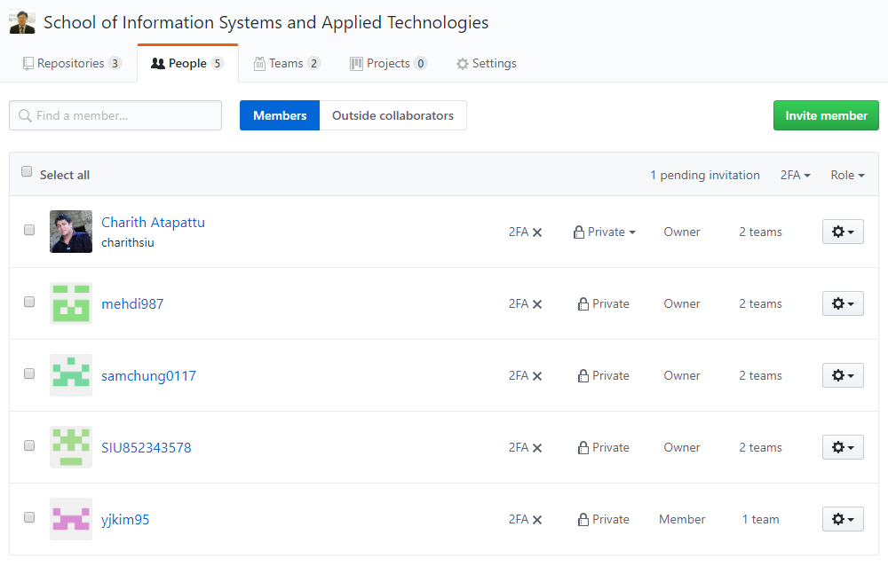
GitHub repository for SEM Project

Slide 16
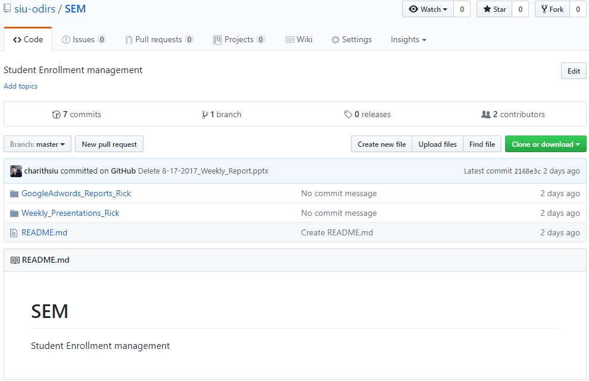
GitHub repository for SEM Project

Slide 17
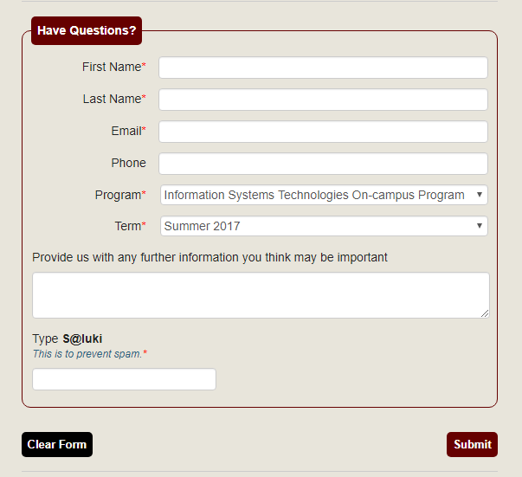
Student Registration form
Implementing AUTO_EMAIL and AUTO_SMS Using MEAN web technology.

